Slide 1


Dibimbing
final project
data analyst
Optimizing Customer Engagement Using RFM Segmentation in Pakistan’s E-Commerce Market
By Raditya Erlang Arkananta

Slide 2

01
Introduction
02
Previous Projects
03
Main Project
04
Overview
Findings
05
Insight & Recommendation

Slide 3



about me
Raditya Erlang Arkananta
Experience
PT Hekikai Indonesia - QA QC Japanese Translator
PT Indonesia Indicator - HR Officer Staff
2024 - 2025
2024
Education
Institute Technology of Sepuluh Nopember
Bachelor of Science in Industrial Engineering
Dibimbing Data Science
Currently Learning Data Scientist Skills
2019 - 2023
"To Bring Value by Turning Complex Data into Actionable Insights”
2024 - 2025
LinkedIn

Slide 4



previous
projects
Overview
E-Commerce Customer Analysis
Advertisement A/B Testing
Customer Sentiment Analysis
Product & Customer Analysis in E-Commerce
Advertisement Impact A/B Testing
Customer Sentiment in Ticketing System
Analyzed the test results of two groups, each exposed to different ads, and identified the one with significantly better performance
Calculated the duration and sample size for the A/B test ro be held reliable.
Analyzed customer satisfaction using key metrics such as CSAT, CES, and NPS
gathered insights oncustomer sentiment and feedback by Analyzing comments
Found that customer service area need improvement
Found the need to make more people recommend the product
Identified the most popular item overall and during peak hours,
Uncovered a clear seasonal trend
Discovered a promising potential foreign market
Found that most revenue comes from the top 20% customer

Slide 5

MAIN PROJECT
Optimizing Customer Engagement Using RFM Segmentation in Pakistan’s E-Commerce Market
All The Script and other Technical Documentation can be Accessed Here

Slide 6
project overview
This project aims to analyze the largest Pakistan e-commerce dataset to gain a deeper understanding and insights into customer behavior.
Background
Problem Statement
What We Will Do
The Dataset is from Kaggle about the Pakistan E Commerce Data from 2016 - 2018
E-Commerce Market is Pakistan is Rapidly growing
Businesses struggle to understand diverse customer behaviors and preferences.
Without clear segmentation, marketing efforts are often generic, leading to inefficient resource allocation, lower customer engagement, and missed opportunities for personalized strategies.
Determining customer segmentation.
Identifying customer habits and suggesting tailored strategies for each segment.
Enhancing personalized marketing to increase sales.
Optimizing resource allocation to improve customer acquisition and retention.

Slide 7



objective
Main Objective
This project aims to perform RFM Analysis on e-commerce data to identify distinct customer groups based on behaviors, preferences, and purchasing patterns. Using these insights, businesses can tailor marketing strategies, optimize customer engagement, and enhance retention efforts. The recommendations hopes to drive personalized marketing, improve customer satisfaction, and ultimately boost sales.
Key Questions
How do sales trends evolve over time?
How are customers segmented based on transaction data?
What is the profit contribution of each customer segment?
What is the most popular product category?
Which payment method is used most frequently?
How many orders have been canceled?
What is the relationship between payment methods and order status?
Which payment method generates the highest sales revenue?

Slide 8




Data understanding
This Dataset from Kaggle contains transaction records from the largest retail e-commerce platform in Pakistan, covering approximately half a million orders, Collected from various e-commerce merchants as part of a research study.
This Dataset Contains :
584 Ribu Data
21 Columns
March 2016 - August 2018

Slide 9
data pre-processing
1
2
3
4
Removing Duplicates
Handling Missing Value
Handling Illogical Future Transaction Dates
Removing Negative Values in Order Quantity and Discount
5
6
7
Adjusting Incorrect Data Types
Dropping Irrelevant Columns
Saving the Pre-Processed Data for Power BI Analysis

Slide 10


pre-processing result
584523 Data
21 Columns
Data Cleaning
584445 Data
15 Columns

Slide 11



Rfm segmentation
Recency
5
154 Days
4
277 Days
3
400 Days
2
587 Days
1
Number of days since customer’s last purchase
Frequency
5
5 Order
4
4 Order
3
3 Order
2
2 Order
1
Count of Transaction
Per Customer
Monetary
5
1250 Rupee
4
550 Rupee
3
55 Rupee
2
6 Rupee
1
How much Money
has a Customer
Spent

Slide 12









Segment explanation
Champion
Emerging Champ
Bulk Spender
Loyalist
Top customers with frequent purchases, spend the most, and shop recently.
Customers whose high in all category but just a little lower thant the top
Recent customers that buy less frequently, but in high amount
Frequent Customer in varying order value
Keep Engaged, Subscription Bonus
Exclusive deals, Personalized Recommendation,
Push Incentives or Bonus
To Push Into Champion
Push for Repeat Purchases
Slipping Away
High Potential
Average
Casual Spender
Active Savers
Irregular Buyer with Varying shopping habits
High spenders with lower frequency and potential for growth
Average shoppers who prefer budget-friendly options.
Seldom buyer, low spender but recently shopped
Frequent and Recent Customer with low spending
Push Notifications, Comeback Promos & Reminder
Targeted Promotion
& Reminders
Highlight Discounts & Bundle Deals
Push for Purchase, Limited Time Offers
Combo Deals, Bonus After Certain Spent

Slide 13
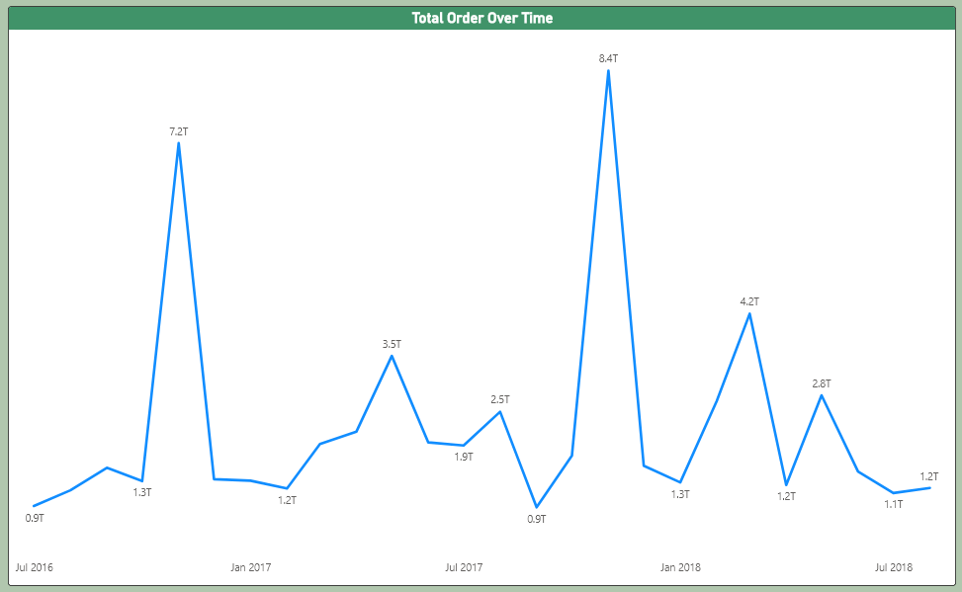
order over time
There is a noticeable peak in November, likely due to:
Islamic Holiday
Wedding Season in Pakistan
The End-of-Year Sale Period
September and October showing notably low activity. There's also some noticeable activity growth between March and May, which may have potential for growth

Slide 14
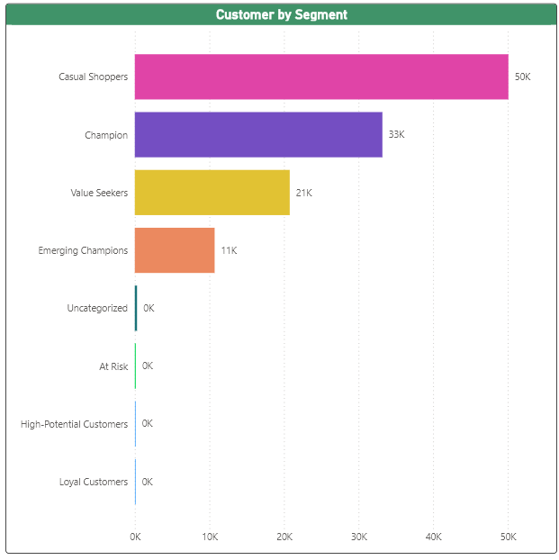
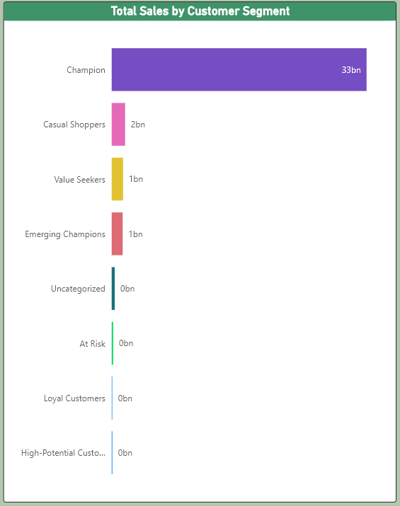
customer & sales by segment
86% of total sales come from the Champion segment, which is 28% of the customer base.
This indicates the need to highlight the importance of targeting and retaining this high-value segment

Slide 15
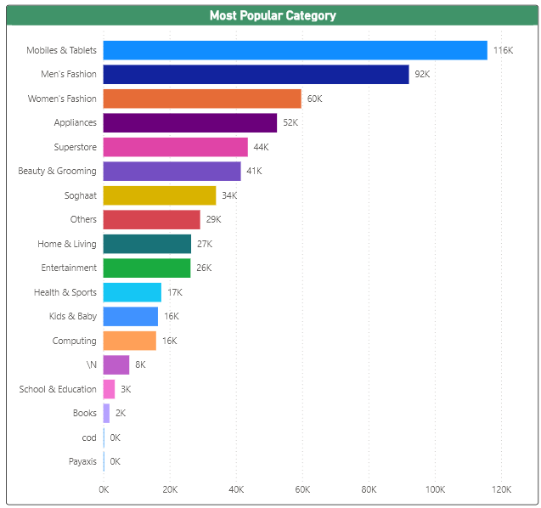
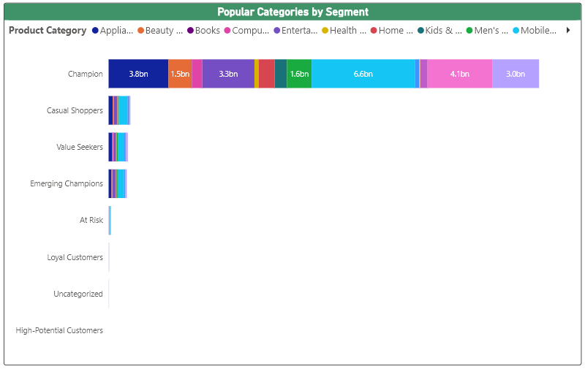
Top Category and Sales by Segment
Mobile & Tablet is the most popular category overall and across all customer segments. Notably, only the Champion segment purchases products from the 'Superstore' category.
Mobile & Tablet products are universally popular, so broadening the offering in this category could cater to all segments effectively

Slide 16
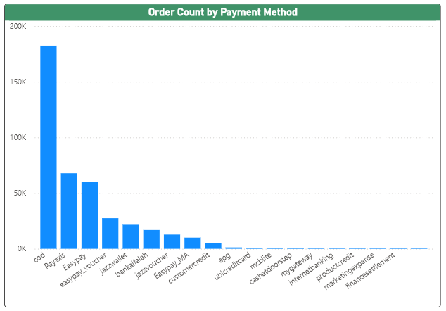
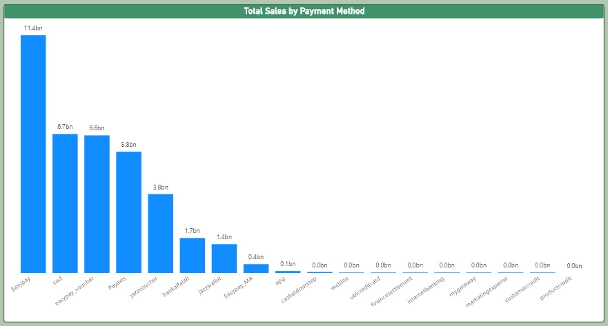
Top Payment method & Sales
Despite Cash on Delivery being the preferred payment method for 44% of customers, Easypay, used by only 14% of customers, contributes the most to revenue. And the third highest contributor is Easypay Voucher, used by 6% of customers.
Customers using digital payment methods might have higher average transaction values, there might be value in refining the digital payment options to drive higher revenue in spite of Lower Customer Base.

Slide 17
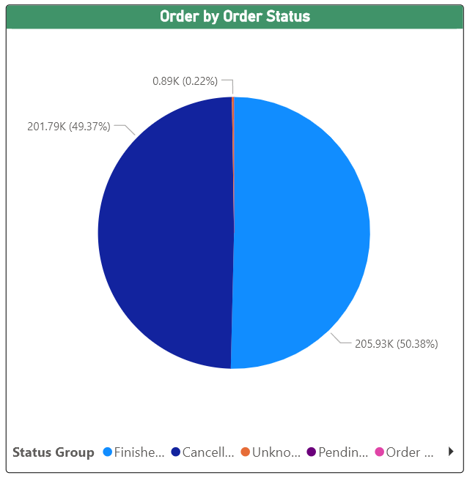
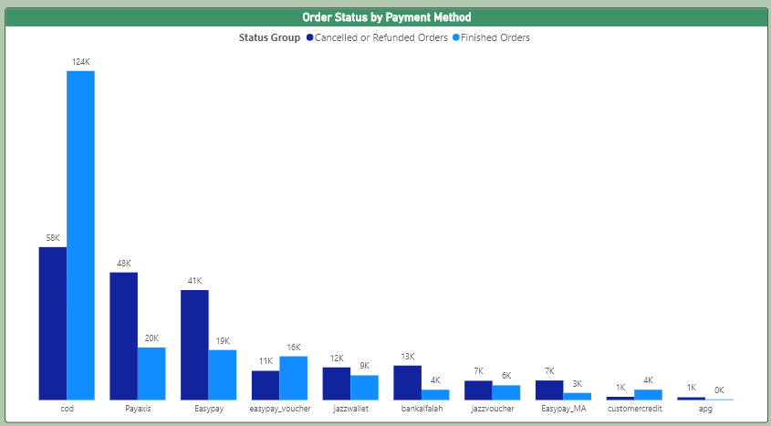
order status by payment method
Almost all payment methods, other than Cash on Delivery (CoD), have higher order cancellation rates than finished. This could be due to the convenience and ease of digital marketplaces, where customers may change their minds or face more payment issues.

Slide 18
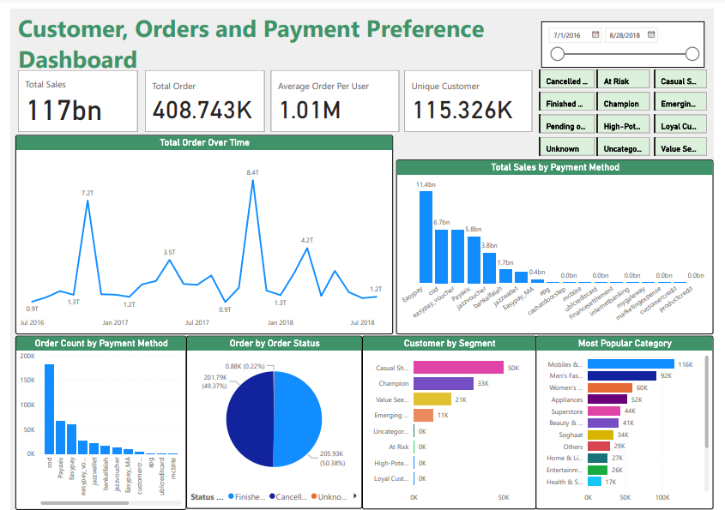
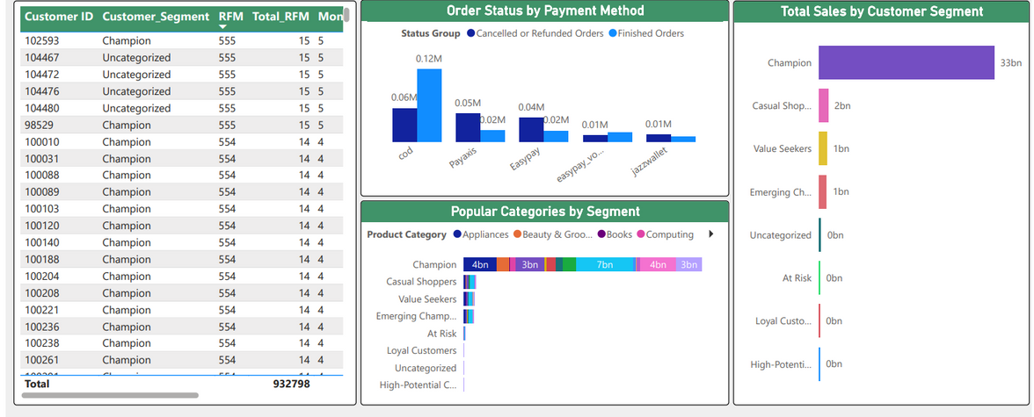
Dashboard
This Dashboard is made to monitor and display customer status, providing Stakeholders with an intuitive and streamlined view for easier decision-making

Slide 19
insight & Recommendation
Seasonal Optimization
There is a clear peak in sales during November, we can allocate more staff and increase marketing efforts during this period to maximize profit. Additionally, we can push marketing between March and May to explore potential opportunities and see whether it's worth investing further to boost sales during this timeframe.
Segment-Specific Marketing
While having a large portion of sales from one group is beneficial, we should encourage other segments to contribute more by implementing targeted marketing strategies for each group. We should also keep the Champions engaged by loyalty program, personalized offers, premium support and such.
Improve Payment Options
Since the Easypay payment method contributes the most to sales, we should integrate it into the system and refine it for smoother transactions. Additionally, we should analyze why customers using this method tend to spend more and use those insights as a benchmark to enhance other payment options.

Slide 20
insight & Recommendation
Optimizing the Most Used Payment
The number of Customers who still prefer Cash on Delivery is the highest. To optimize this, we can enhance logistics and processes to ensure timely delivery, reduce cancellations, improve customer satisfaction, and ultimately boost sales
Reduce Cancellation
The high number of cancellations calls for improvement. These cancellations could be due to payment issues. To address this, we can offer multiple payment options, send reminders for pending payments, and provide real-time updates on order status and tracking to reduce cancellations
Potential Segment
The Casual Shopper segment has the highest number of customers, so we can try to focus our marketing efforts on this group to encourage higher spending and increase overall revenue.

Slide 21
insight & Recommendation
Better Data Keeping
The Missing Data of Product Names and Description Makes it Difficult to Analyze what kind of Product is Popular as the Dataset only store its Internal SKU (Stock Keeping Unit) ID In the Dataset

Slide 22


Thank You
Raditya Erlang Arkananta
Slides & Graphic used are Created Using Canva
Erlang_work@yahoo.com
Raditya Erlang A.
wa.me/6281218900315

